Slide 1


Quantum Hackathon
Qilimanjaro Software Challenge

Slide 2
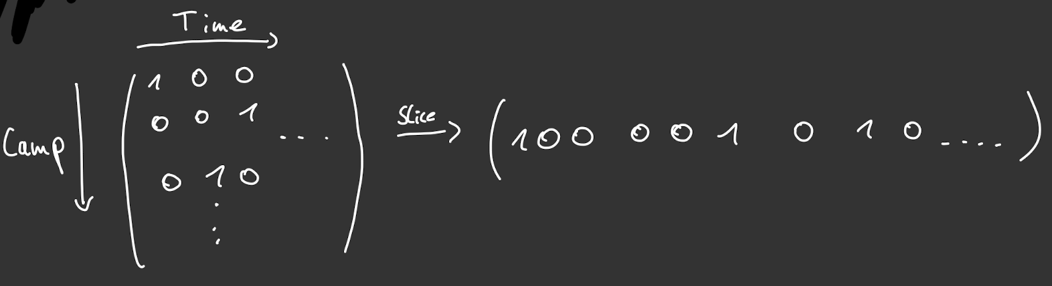
Traveling Salesman Problem (TSP) - Bitstring Definition

Slide 3
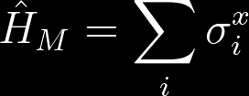
Mixer Used

Slide 4
TSP - Quantum Alternating Operator Ansatz (QAOA)
3 Node Problem Cost Hamiltonian
Path dependent loss
Penalty for double visit
Penalty for simultaneous visit
5 Node Problem Cost Hamiltonian
Path dependent loss
Penalty for double visit
Penalty for simultaneous visit
Penalty for non existing edge

Slide 5


TSP- 3 Node Problem
QAOA
Adiabatic Quantum Optimization

Slide 6
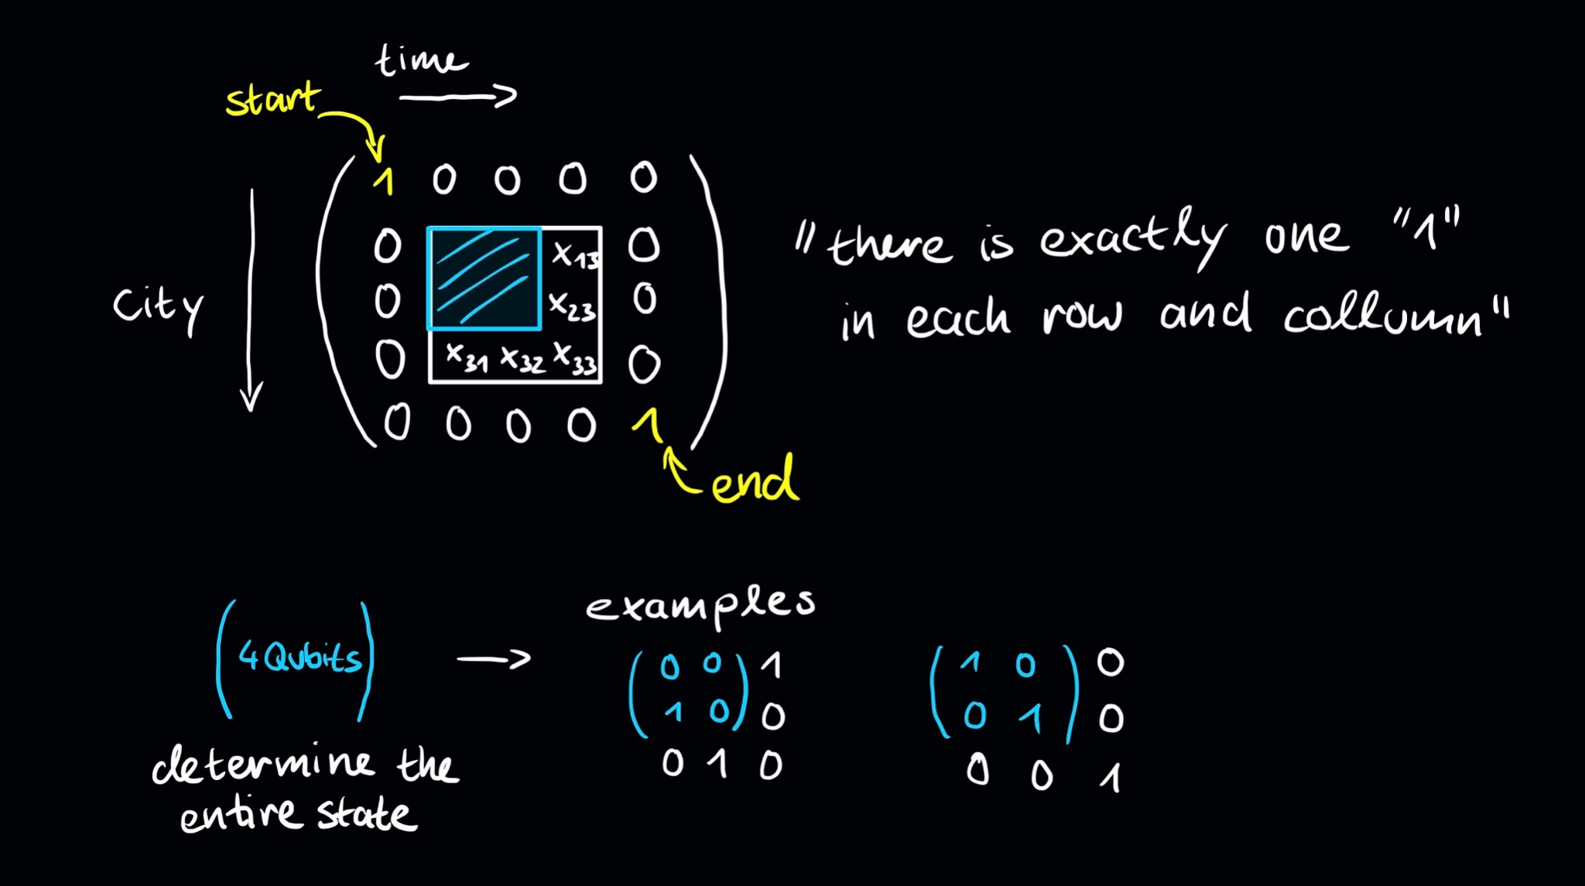
5 Nodes Problem with 4 Qubits

Slide 7


TSP- 5 Node Problem
QAOA
Adiabatic Quantum Optimization

